Slide 1
The TCA Cycle and the ETC

Slide 2
Quiz Question #1
The final electron acceptor in the electron transport chain is
NAD (becoming NADH)
FAD (becoming FADH₂)
Pyruvate (becoming Acetyl-CoA)
O₂ (becoming H₂0)

Slide 3
Quiz Question #2
The most important metabolite for regulating activity of the electron transport chain is:
ATP
ADP
NADH
FADH₂

Slide 4
Quiz Question #3
What drives the ATP generating pump in the mitochondria?
Calcium gradient
Potassium gradient
Proton gradient
Substrate level phosphorylation

Slide 5
Learning Objectives
Describe the key regulatory nodes of the TCA cycle.
Understand the concept of anaplerosis and cataplerosis and how this can effect TCA cycle efficiency.
Explain the differences in efficiency between anaerobic glycolysis and the TCA cycle linked to the electron transport chain.
Understand how mitochondria balance nutrient flux with ATP requirements.

Slide 6
Pyruvate Transport and Oxidation

Slide 7
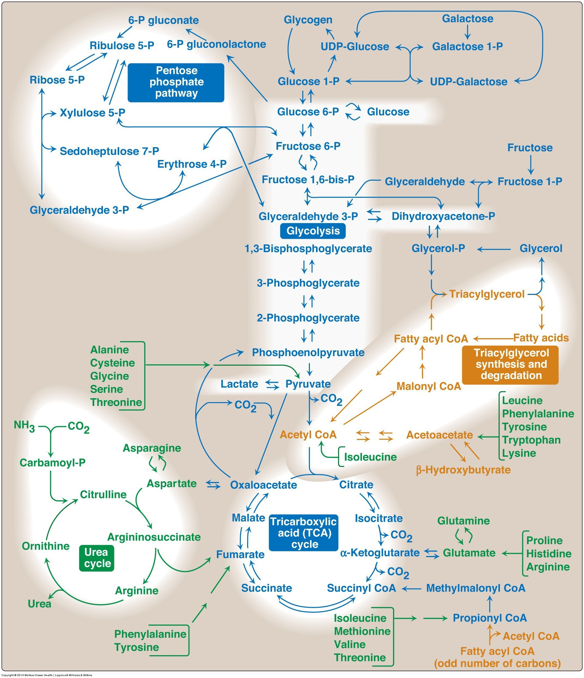
Fates of the Pyruvate from Glycolysis
Aerobic Conditions
Becomes Acetyl-CoA
In presence of CHO but need energy -> TCA Cycle
In presence of CHO but don’t need energy -> Lipids
In absence of CHO (relevant for lipid oxidation)
Ketone Bodies (if OAA absent)
Gluconeogenesis (if OAA present)
Anaerobic conditions
Becomes lactate
Lactate goes to liver for reconversion back to glucose
Notes:
Absent of CHO is mo

Slide 8
Lactate Dehydrogenase
Notes:
Mention what NADH is

Slide 9
What is a NADH (or a FADH2 or a NADPH)

Slide 10
TCA Cycle Net ATP
Glycolysis
Uses 2 ATP (GK/HK and PFK1) -2ATP
Generates 2 DHAP/Ga3P Each of which:
Generates 2 ATP -> +4 ATP total
Generates 1 NADH -> +5 ATP (2.5 ATP/NADH)
Net to Pyruvate-> 5 + 4 – 2 = 7ATP
Net to Lactate
Generates 1 more NADH for each pyruvate -> +12 ATP
Through TCA/ETC ~ 32 ATP
Each pyruvate generates 4 NADH, 1 FADH2 and 1 ATP
Glycolysis (Glucose to Pyruvate) = 7ATP
4 NADH x 2.5 = 10 ATP x 2 Pyruvates = 20 ATP
1 FADH x 1.5 = 1.5 ATP x 2 Pyruvates = 3 ATP
1 GTP = 1 ATP x 2 Pyruvates = 2 ATP

Slide 11
Pyruvate Oxidation Occurs in Mitochondria
All three of the next steps are mitochondrial
Pyruvate Oxidation
TCA Cycle
Electron Transport Chain
Pyruvate needs to be transported into mitochondria

Slide 12
The mitochondria is the powerhouse of the cell
Notes:
Mention the radiolab podcast

Slide 13
The number of mitochondria per cell can be modified

Slide 14
Pyruvate Dehydrogenase
Making acetyl-CoA

Slide 15
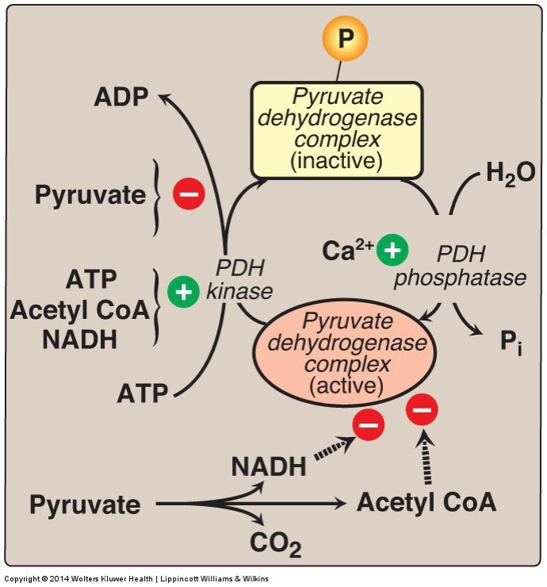
How is the decision made whether pyruvate should become Lactate or Acetyl-CoA
Allosteric regulators
NADH
Acetyl-CoA
Through Phosphorylation and inactivation by PDH Kinase
ATP
NADH
Acetyl-CoA
Pyruvate
Ca

Slide 16
Wernicke-Korsakoff Syndrome
Thiamine (Vitamin B1) is a cofactor for PDH as well as some other enzymes
Ethanol inhibits thiamine uptake in GI system
A more minor deficiency is called Beriberi
Symptoms include
Lactic acid and pyruvate buildup
High output cardiac failure
Exercise intolerance
Neurodegeneration, numbness, poor reflexes

Slide 17
Acetyl-CoA can now go in several directions

Slide 18
The Fates of Pyruvate/Acetyl-CoA
Aerobic Conditions
Becomes Acetyl-CoA
In presence of CHO but need energy -> TCA Cycle
In presence of CHO but don’t need energy -> Lipids
In absence of CHO (relevant for lipid oxidation)
Ketone Bodies (if OAA absent)
Gluconeogenesis (if OAA present)
Anaerobic conditions
Becomes lactate
Lactate goes to liver for reconversion back to glucose

Slide 19
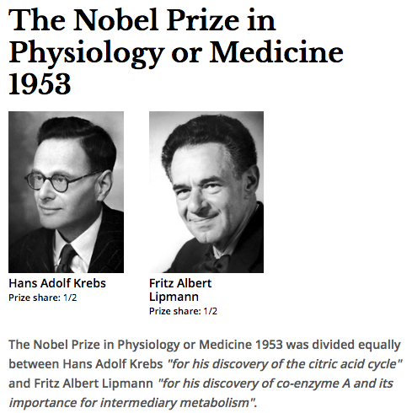
TCA Cycle
AKA Krebs Cycle
AKA Citric Acid Cycle

Slide 20
Simple View of the TCA Cycle
The outcomes of this reactions are
NADH and FADH₂ will be used in the electron transport chain
GTP can be interconverted to ATP
Both carbons that were part of Acetyl-CoA are now released as CO₂
Acetyl-CoA + 3 NAD⁺ + FAD + GDP + P_{i} + 2 H₂O | → CoA-SH + 3 NADH + FADH₂ + GTP + 2 CO₂
Notes:
Mention CO2 is totally irreversible

Slide 21
The TCA Cycle Releases Energy in the Form of Electron Carrier Molecules

Slide 22
The Regulated Steps of the TCA Cycle
Citrate Synthase
NADH, FADH₂, ATP
OAA, AMP
Isocitrate Dehydrogenase
NADH, ATP
ADP, Ca²
α-Ketoglutarate Dehydrogenase
NADH
Ca²⁺
Notes:
Steps 1, 3 and 4 are the regulated steps.

Slide 23
What enzymes are regulated by Energy Status?
AMP/ADP/ATP
NADH
Glycolysis
PFK1
Pyruvate Kinase
Pyruvate Dehydrogenase
TCA Cycle
Citrate Synthase
Isocitrate Dehydrogenase
Pyruvate Dehydrogenase
Pyruvate Dehydrogenase Kinase (inhibitory to PDH)
α-Ketoglutarate Dehydrogenase
Hormonal regulation of the TCA cycle?
Notes:
Hormones

Slide 24
Other metabolites feed into, or take from the TCA cycle
Fatty Acid biosynthesis draws from citrate
Amino Acids feed into and draw from several steps in the TCA cycle
Notes:
All but one amino acid group feeds into the cycle AFTER the regulated steps

Slide 25
Think about where Amino Acids Feed into the TCA Cycle
Where are they entering relative to regulatory points of the cycle?
Does energy-dependent regulation of the TCA cycle also cause regulation of AA entry into the cycle?

Slide 26
Anaplerosis and Cataplerosis

Slide 27
Which of the following is a cataplerotic pathway
Gluconeogenesis
Lysine catabolism
Fatty acid oxidation
Glycolysis
Notes:
Answer is A

Slide 28
You are surviving on only protein as a macronutrient, is this cataplerotic or anaplerotic?
Cataplerotic
Anaplerotic
Neither
Depends on the situation
Notes:
Answer is B

Slide 29
How does anaplerosis regulate glycolysis?
Oxaloacetate inhibits pyruvate kinase
Oxaloacetate inhibits phosphofructokinase 2
Citrate inhibits pyruvate kinase
Citrate inhibits phosphofructokinase 2
Notes:
Answer is D

Slide 30
Can anaplerosis regulate fructose metabolism
Why or why not? Sketch this out as a diagram on the piece of paper

Slide 31
What if you you are too cataplerotic?
X
Ketone Bodies

Slide 32
Molecular Basis for Ketosis
Aerobic Conditions
Becomes Acetyl-CoA
In presence of CHO but need energy -> TCA Cycle
In presence of CHO but don’t need energy -> Lipids
In absence of CHO (relevant for lipid oxidation)
Ketone Bodies (if OAA absent)
Gluconeogenesis (if OAA present)

Slide 33
Summary of Regulation of the TCA Cycle
Key points of regulation include:
Mitochondrial levels
Pyruvate/Acetyl-CoA production (Glycolysis/Fatty Acid Oxidation)
Energy levels (AMP/ADP/ATP and NADH, FADH₂)
Levels of TCA cycle intermediates
Intramitochondrial calcium levels

Slide 34
The Electron Transport Chain

Slide 35
The ETC uses the electron carriers to generate a proton gradient

Slide 36
CoEnzyme Q
Lipid Soluble Cofactor
Sold as an unregulated dietary supplement
What for?
Notes:
http://www.mayoclinic.org/drugs-supplements/coenzyme-q10/evidence/hrb-20059019

Slide 37
ATP is Generated by a Proton-Driven Pump

Slide 38
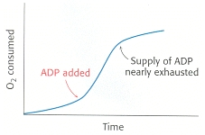
Regulation of ETC Efficiency
Primary regulator of the ETC is energy demand (ADP/ATP ratio)

Slide 39
Respiratory Control by Energy Needs
All substrates
are present

Slide 40
Inefficient Coupling of the ETC
Are there any reasons why you may want to have inefficient coupling of the electron transport chain?

Slide 41
Brown Adipose Tissue and Thermogenesis

Slide 42

Mitochondria Animation

Slide 43
Learning Objectives
Describe the key regulatory nodes of the TCA cycle.
Understand the concept of anaplerosis and cataplerosis and how this can effect TCA cycle efficiency.
Explain the differences in efficiency between anaerobic glycolysis and the TCA cycle linked to the electron transport chain.
Understand how mitochondria balance nutrient flux with ATP requirements.

